Slide 1
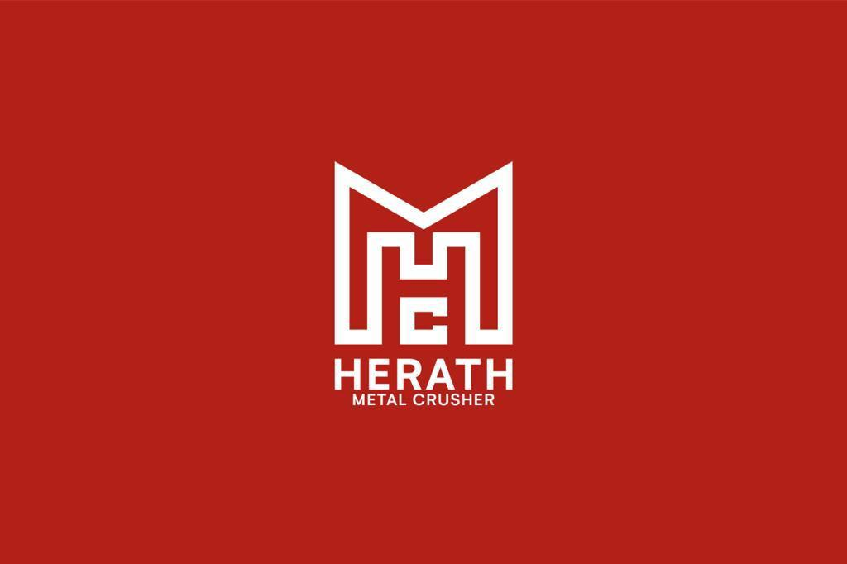

SLIIT ITP PROJECT PROPOSAL ITP PROJECT – CSIT2080 Group – ITP21F_05 Y2S2- 2021

Slide 2
HERATH METAL CRUSHER MANAGEMENT SYSTEM

Slide 3
PROJECT MEMBERS
Ravinda Anjana S.A.D - IT20062538
Dakumpitiya D.A.L.C - IT20187200
Bandara S.A.C.J.W - IT20197278
Wijesinghe W.A.K.R - IT20751296
Nigamuni M.M.S - IT20189426
Kadigamuwa A.S.T.W.M.R.R.W - IT20197100
Mithsara K.A.G.N - IT20190170
Ariyathilake H.L - IT20245788

Slide 4
INTRODUCTION
HERATH METAL CRUSHER is a Metal Crusher which was built up in 2006.
Location – Anuradhapura District
Currently HERATH METAL CRUSHER is using a manual system to handle the crusher’s process.
Our group is interested in building up a new system for the Metal Crusher to manage all their processes efficiently

Slide 5
Problem Specification
Difficult to manage employee details
Limited Space
Problems when finding invoices
Difficulty to manage machine maintenance
Important files may tend to be misplaced
Stock cannot be monitored easily

Slide 6
Solution Outline
Use regular backups
Make all the details computerized
Build a employee attendance detecting system
Getting all work done using a computerized system

Slide 7
Key Benefits
Employee attendance could be marked accurately
Machine maintenance could be done on time
Being able to get the maximum output through machines
Stock can be monitored easily
Could obtain past delivery details whenever needed
Being able to pay wages accurately
Could increase the durability of machines
Could make stock available for a trip anytime

Slide 8
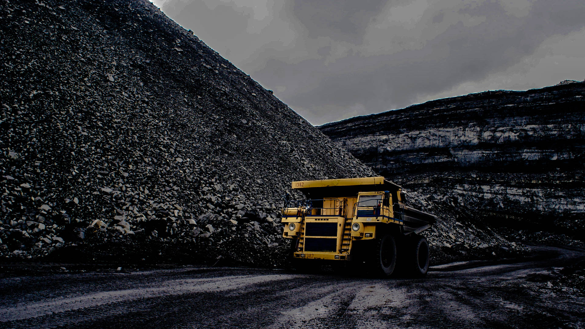

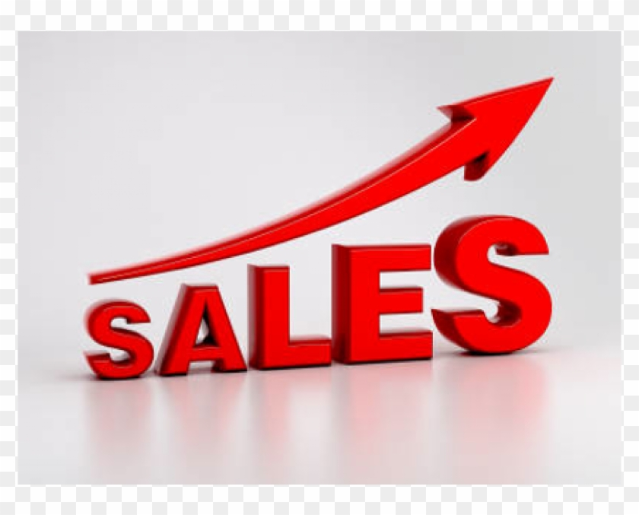


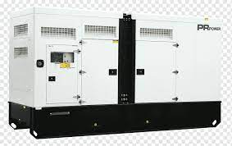


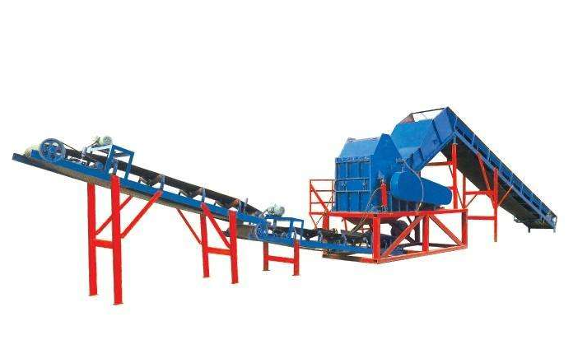



System Overview
Vehicle Management
Other Stock Management
Sales Management
Employee Management
Generator Management
Excavator Management
Crusher Management
Loader Management
Hammer, Compressor Management
Admin Tasks Management

Slide 9
System Functions
Vehicle Repairing, Workload and Maintenance Management of Vehicles
Metal Crusher Machines Repairing, Workload and Maintenance Management
Loader Machines Repairing, Workload and Maintenance Management
Generator Machines Repairing, Workload and Maintenance Management and Sales Management
Administrative Tasks and Employee Attendance Management
Hammer, Compressor Machines Repairing, Workload and Maintenance Management
Excavator Machines Repairing, Workload and Maintenance Management
Other Remaining Items in Stock Management

Slide 10
Vehicle Repairing, Workload and Maintenance Management of Vehicles
Main function is that users would need to see the expenses that they spend specifically for the Vehicle spare parts, Services and repairs done to vehicles in a specific time (ex: daily, monthly, yearly, given date)
Users want to update database when they restock the Vehicle spare parts, repairs and services at the end of the month.
Users want to check whether the wanted spare part is available in stock, if available notify them and reduce the quantity and if not available notify them to buy that from a store
Users want to delete spare parts if they will not import that again
Users want to sort the spare parts by its name or id

Slide 11
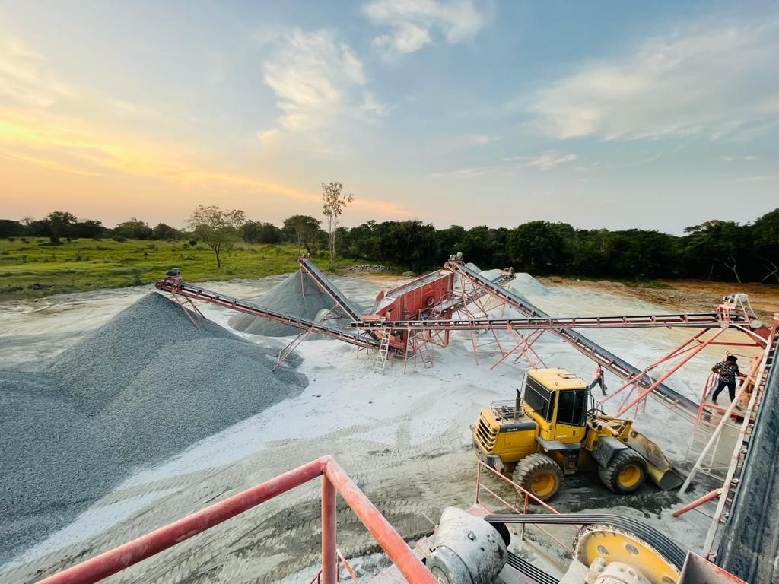
Metal Crusher Machines Repairing, Workload and Maintenance Management
Main function would be that users would need to see the expenses that they spend specifically for the Metal Crusher spare parts in a specific time (ex: daily, monthly, yearly, given date)
Users want to update database when they restock the metal crusher spare parts at the end of the month.
Users want to check whether the wanted spare part is available in stock, if available notify them and reduce the quantity and if not available notify them to buy that from a store
Users want to delete spare parts if they will not import that again
Users want to sort the spare parts by its name or id

Slide 12
Loader Machines Repairing, Workload and Maintenance Management

Slide 13

Generator Machines Repairing, Workload and Maintenance Management and Sales Management
The main function is to enter, update and delete details of the customers.
The system records the sales relevant to the specific customer with the credit or debit amounts.
The generator management main function is consisted of the parts which relevant to the generator with their availability and the quantity.

Slide 14
Administrative Tasks and Employee Attendance Management
The main feature under this function is the ability to record employee attendance
Add, Update, Delete Employee Details in need for authorized personals
Assigning Admin Roles to do any task through the system for relative people.
Giving them separate logins to conduct their tasks

Slide 15
Hammer, Compressor Machines Repairing, Workload and Maintenance Management

Slide 16
Excavator Machines Repairing, Workload and Maintenance Management
The main tasks of this function is to record the expenses in maintaining the excavator, the expenses spent on the spare sparts of this machine and details about each excavators separately.
Each excavator has an ID , type, main task and the next service due(service is done according to work hours). User can update ,delete these information when needed.
The database is updated by the user every single time when a spare part of the excavator is restocked.
User can check the availability of spare parts in the storage, if the desired spare parts are available the system will notify the user and if they are not available the system will give an alert message saying that the storage is empty for the specified spare part. Every time a spare part is taken from the storage, the count of the specified spare part will be reduced.
User can update spare parts if needed and delete spare parts which are no longer needed.
These spare parts are sorted by its name or id.

Slide 17
Other Remaining Items in Stock Management
Add, Update or Delete items from the inventory
Display Available Stocks at the relevant moment
Search Availability of Items
Create and print Monthly stocks report
Send warning message from system when the inventory is reduced

Slide 18
Tools & Technologies
Planning to use software s like,
Eclipse – for IDE to code implementation
Java – as a programming language
Scene Builder – to develop the UI / UX
MongoDB , MYSQL – to create the database
Develop a desktop application using JavaFx frame work.
Other necessary libraries will be used to create quality UI and UX

Slide 19
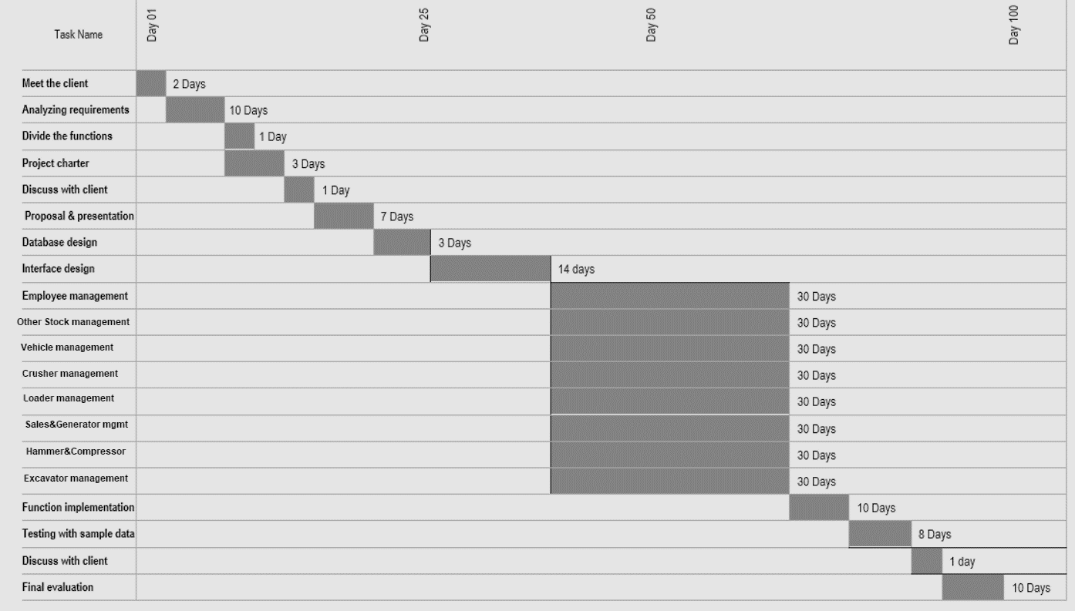
Project Management Plan

Slide 20
Conclusion
Our main goal is to implement a fully automated system for Herath Metal Crushers to get their work done easily and to carry out the business processes effectively & efficiently.

Slide 21
Thank You!

